Slide 1
ANNUAL REPORT
2022

Slide 2

Our Chapter’s Mission
Serve our members and our greater community together by promoting the value and practice of project management to:
    Advance Standards
    Disseminate Best Practices
    Offer Professional Development Opportunities
    Connect Members For Career Development
This Photo by Unknown Author is licensed under CC BY-NC

Slide 3

Our Values
Professionalism
Community
Volunteerism
Engagement

Slide 4
Membership Programs
Deliverable | Planned | Actual
Chapter meetings | 10 planned | 10 in-person
Professional Development Day | 1 virtual | cancelled due to low interest
Mentorship Program | Virtual program planned | Successfully launched in the fall
Member Give Back | 1 | Held 1 webinar - DE&I in Project management
Increase membership | 2-3% | Increased 8%
Social Good | 1 | Community Garden

Slide 5
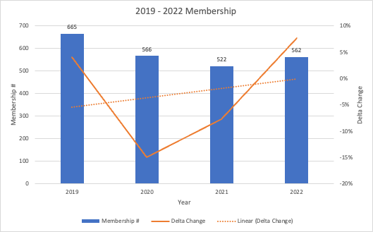
Membership YoY

Slide 6
2022 Operations Financials
Membership $13,223
Net Operating ($11,446)
Operating Income ($1,778)

Slide 7
2022 Chapter Meeting Financials
Plan is to break even
Income
$1,843
Net Income $1,843
Sponsorship $0

Slide 8
2022 Professional Development Financials
Events $409
Net Income ($165)
Expenses ($574)

Slide 9
2022 Totals Financials
Beginning Cash Balance $92,418
Net Income/Loss
(230)
Ending Cash Balance $92,188

Slide 10
THANK YOU
MICHELE CARTER
2022 PRESIDENT, PMI CENTRAL MASS
  president@pmicmass.org

