Slide 1
PMI Central Mass Chapter
2019 Annual Report

Slide 2
Chapter Mission
To promote the value and practice of project management by advancing standards, providing a forum for disseminating best practices information, and sponsoring professional development opportunities

Slide 3
Our Vision
To be widely recognized in the Central Massachusetts area among our members and the business community as a dynamic, energetic, volunteer organization of professionals, which is instrumental in the development and advancement of the knowledge and practice of project management.

Slide 4
Organization Overview
The Project Management Institute - Central Mass Chapter is a non profit organization which obtained its charter in April, 2003, and was founded to provide a "network of project management expertise" and "community" for its members and a project management resource for the public and private sector in the Central Massachusetts area. We sponsor face-to-face meetings with peers from various organizations and industries working in the project management profession.
Notes:
Should the word "community" also be in red?

Slide 5

Our Values
Professionalism
Community
Volunteerism
Engagement

Slide 6
Members with PMI Credentials
Credentials | 2018 | 2019 | Change
PMP® (Project Management Professional) | 439 | (91.2%) 446 | 7
PMI-ACP® (Agile Certified Practitioner) | 28 | (5.9%) 29 | 1
CAPM® (Certified Associate in Project Mgmnt) | 6 | 9 | 3
PMI-RMP® (Risk Management Professional) | 2 |  | -2
PgMP® (Program Management Professional) | 2 | 2 | 0
PMI-SP® (Scheduling Professional) | 1 | 1 | 0
PMI-PBA® (Professional In Business Analysis) | 1 | 1 | 0
Total Credential Holders | 479 | (73.7%) 488 | 9
Total Number of Members | 641 | 662 | 21

Slide 7
Our Members Industries
Industry | 2018 | 2019
Information Technology | 22.3 % | 20.4 %
Healthcare | 14.5 % | 14.4 %
Financial Services | 8.2 % | 7.3 %
Consulting | 7.8 % | 8.4 %
Manufacturing | 6.2 % | 6.9 %
Pharmaceutical | 5.9 % | 6.7 %
Government | 2.8 % | 3.0 %
Training | 2.7 % | 2.5 %
Energy | 2.2 % | 3.1 %
Telecommunication | 2.0 % | 1.5 %
Others (Construction,Aerospace, Food Bev, Legal, Automotive, unspecified) | 25.3 % | 25.7 %
Notes:
Again, a footnote on when the data was collected

Slide 8
Survey*: 2018
Member Satisfaction
Satisfaction Results | Chapter | Region | Diff.
Overall Satisfaction (Very satisfied, satisfied) with membership & leadership | 77% | 67% | 10%
Overall Satisfaction Mean Score | 4 | 3.8 | 0.2
Likelihood to recommend the Chapter | 79% | 69% | 10%
Likelihood to Renew Chapter Membership | 79% | 72% | 7%
Overall Value of Chapter Membership | 61% | 49% | 12%
* Statistics from annual PMI Survey.
Results for 2019 survey will be available June 2020

Slide 9
Long Term Goals
Enhance outreach and engagement plan for members
Engage and partner with local professional communities
  raise chapter brand awareness
  foster chapter community engagement
Streamline operational excellence and volunteer on boarding
Offer Value to the Members

Slide 10
2019 Goals
Operations Excellence Improved internal communication Collaboration tools to gain efficiency
Members Engagement / Value to Members Piloting Mentoring Program (in Pilot phase) Webinar Series by Members for Members (shelved)
Outreach Collaborate with businesses

Slide 11
2019 Accomplishments
Held 2 Webinars in addition to regular Chapter Meetings
Offered PMP and ACP Prep classes in both the Spring and Fall
Hosted a Network Social in June 2019
Held a full-day Professional Development Day in August
Pilot offering of Mentoring Program in 2020
Notes:
Added formal networking to our Chapter MeetingsGrew our membership while staying within our preferred membership rangeWebinars are now part of our core offerings

Slide 12
Chapter Offerings
Monthly Chapter Meeting (9-10 per year)
Webinars (4-6 per year)
Quarterly Newsletter
Professional Development Day (once in August)
Exam Preparation Courses (3 offerings)
Other Professional Training
Jobs Board
Mentoring Program (Piloted Jan 2020)

Slide 13
Chapter Outreach
Attend the annual PMI Region 3 Summit to learn and network with other PMI Chapters
Attend annual PMI Leadership Conference
Speak at local colleges to promote the profession
  Beatriz (Dir. Of IT) at UMass Amherst
  Amy (Dir at Large) at Clark University
Sit on the Advisory Board for Project Summit
Sponsored 2019 Annual Worcester Women's Leadership Conference

Slide 14
Chapter Meetings 2019
The AIPMM Phase Review Process: How Project Managers can work with Product Managers to build better products
The Agile Building Block "User Story"
Surviving Your First Agile Project
Recovery Machine
Surprise! The US Military Gets Creative & Agile
Project Manager vs. People Manager, Panel Discussion
The 5 Frustrations of Project Leadership - And How to Conquer Them
Annual Career Focus and Networking Meeting

Slide 15
Webinars 2019
The Importance of Real-Time Project Data for Strategic Decision Making
How to Facilitate Productive Project Planning Meetings

Slide 16
2019 Financials
Chapter Meeting Income (Loss) | ($ 493)
Chapter Meeting Sponsorship | $ 1,140
Net Chapter Meeting Income |  | $ 648
Membership Dues | $ 16,820
Net Operating Expenses | ($ 22,411)
Operating Income (loss) |  | ($ 4,591)
Special Events | $ 39,573
Special Events Sponsorship | $ 499
Special Events Expenses | ($ 25,364)
Professional Development Income |  | $ 14,707
Net Income (loss) |  | $ 10,765
Beginning Cash |  | $ 81,779
Net Income (Loss) |  | $ 10,765
Ending Cash |  | $ 92,543

Slide 17
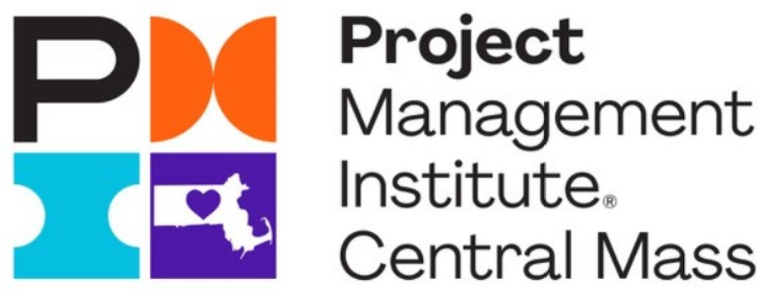
Our New Brand Logo

